Slide 1
Sentinel
By University of Waterloo Healthcare Innovation Team (UWHIT)

Slide 2
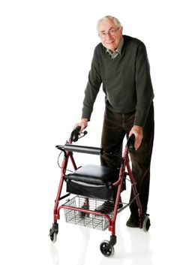
Meet George
70 years old
Walker user
Minor cognitive decline

Slide 3

The Problem
There are a lot more people like George
High healthcare cost - $ 2 billion in Canada
Fast growing senior population

Slide 4

Current Solutions?

Slide 5
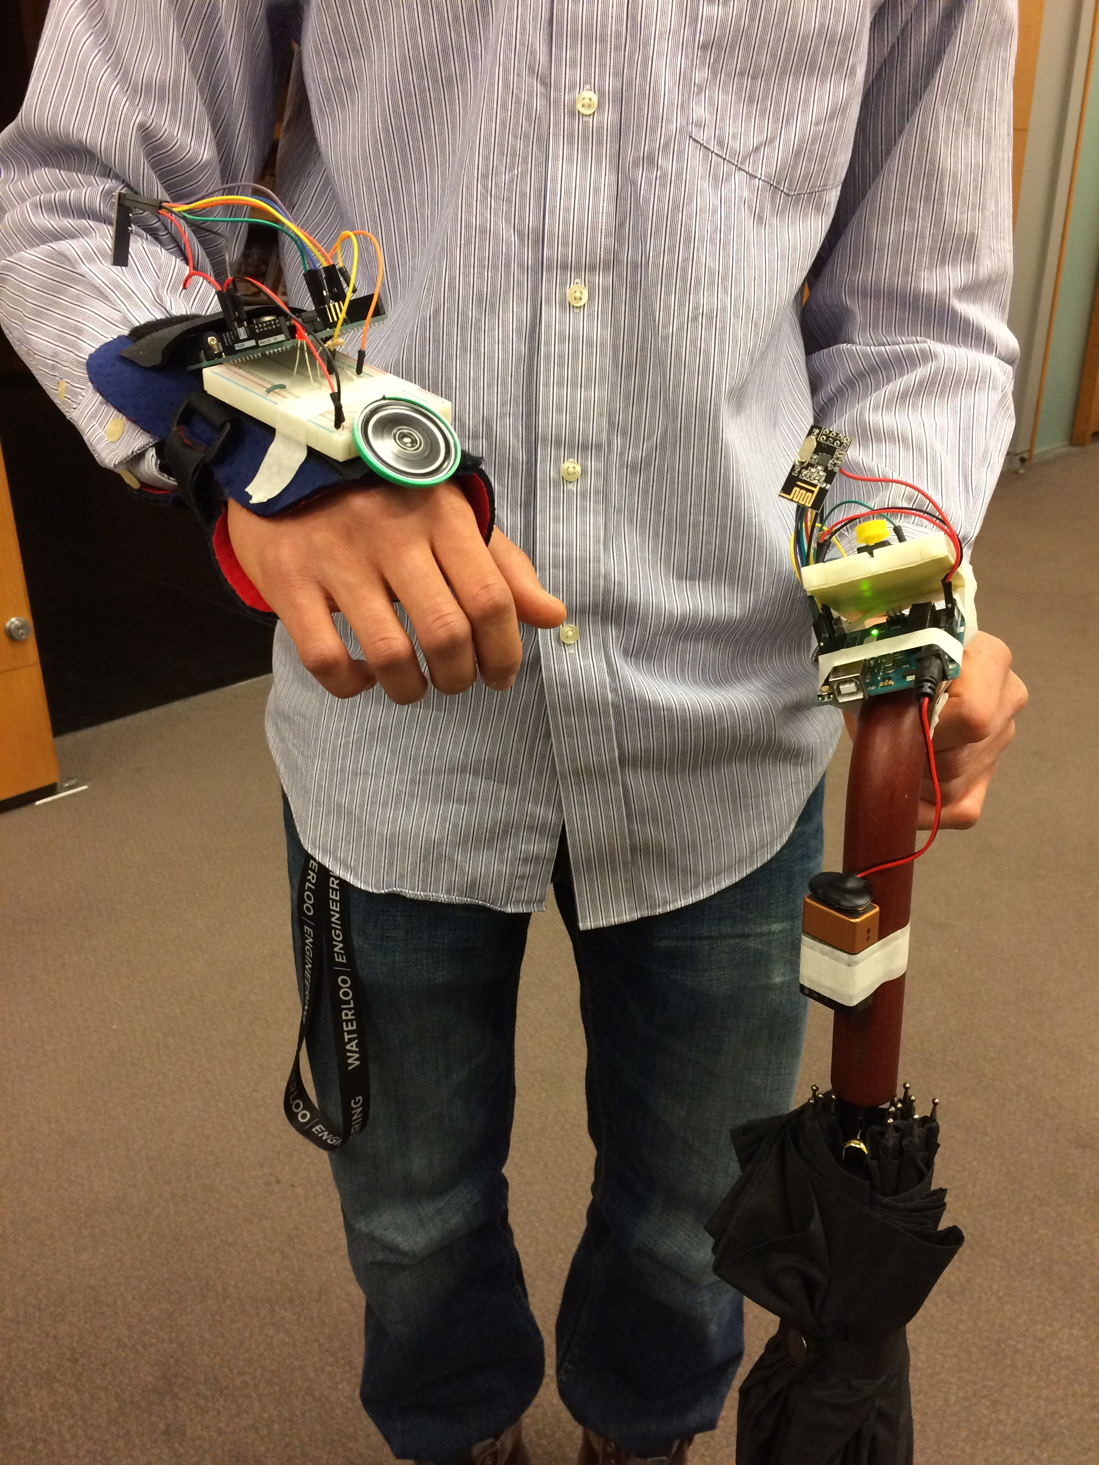
Meet Sentinel
A walker to remember

Slide 6
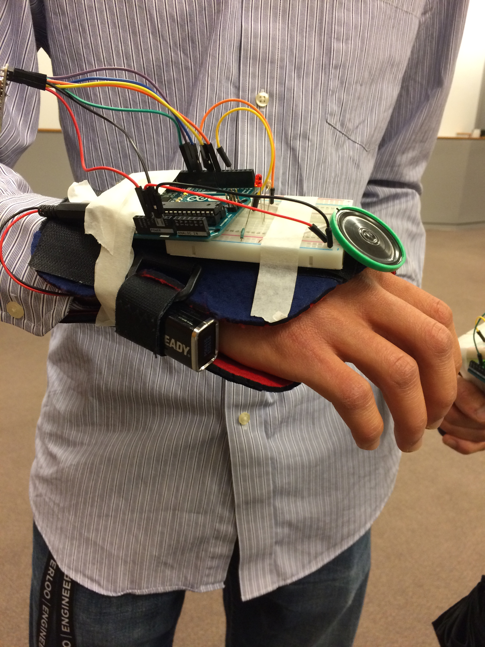
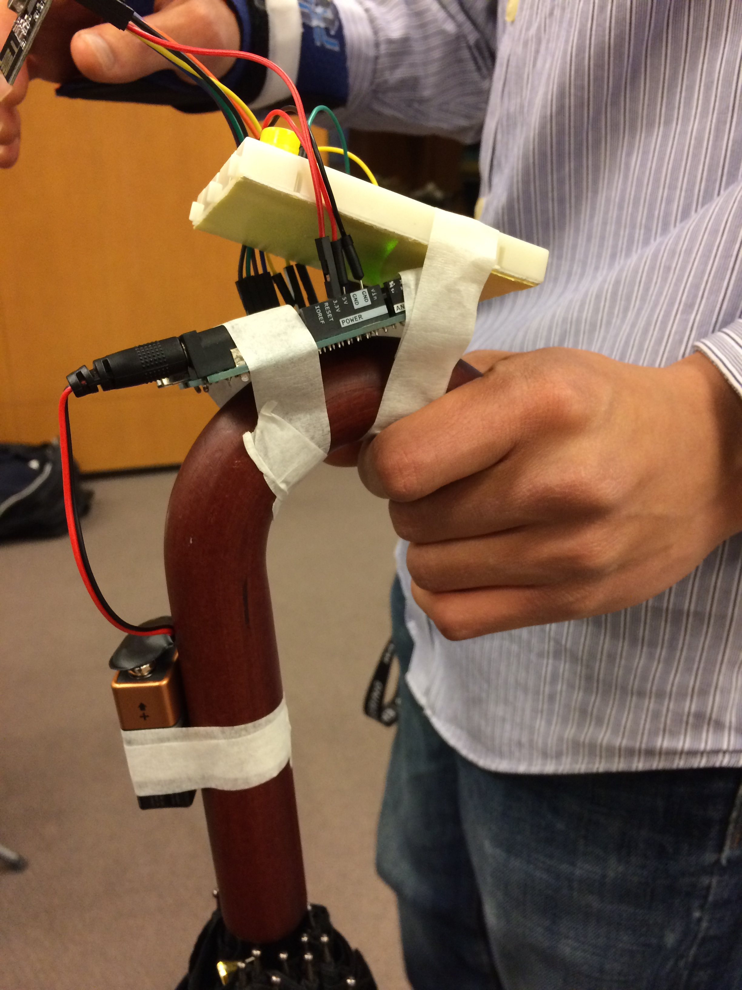
↓ Wearable bracelet
↑ Walking aid attachable

Slide 7
Demo

Slide 8
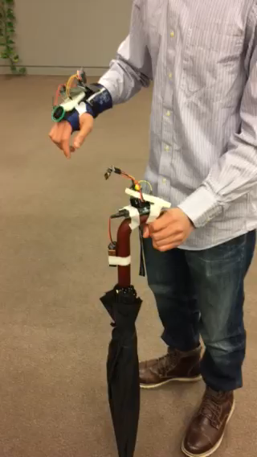

Slide 9

Business Practicality
$ 30 - 50 per unit
Companies for sales channels
Shoppers Home Health Care
Insurance companies for cost for users

Slide 10
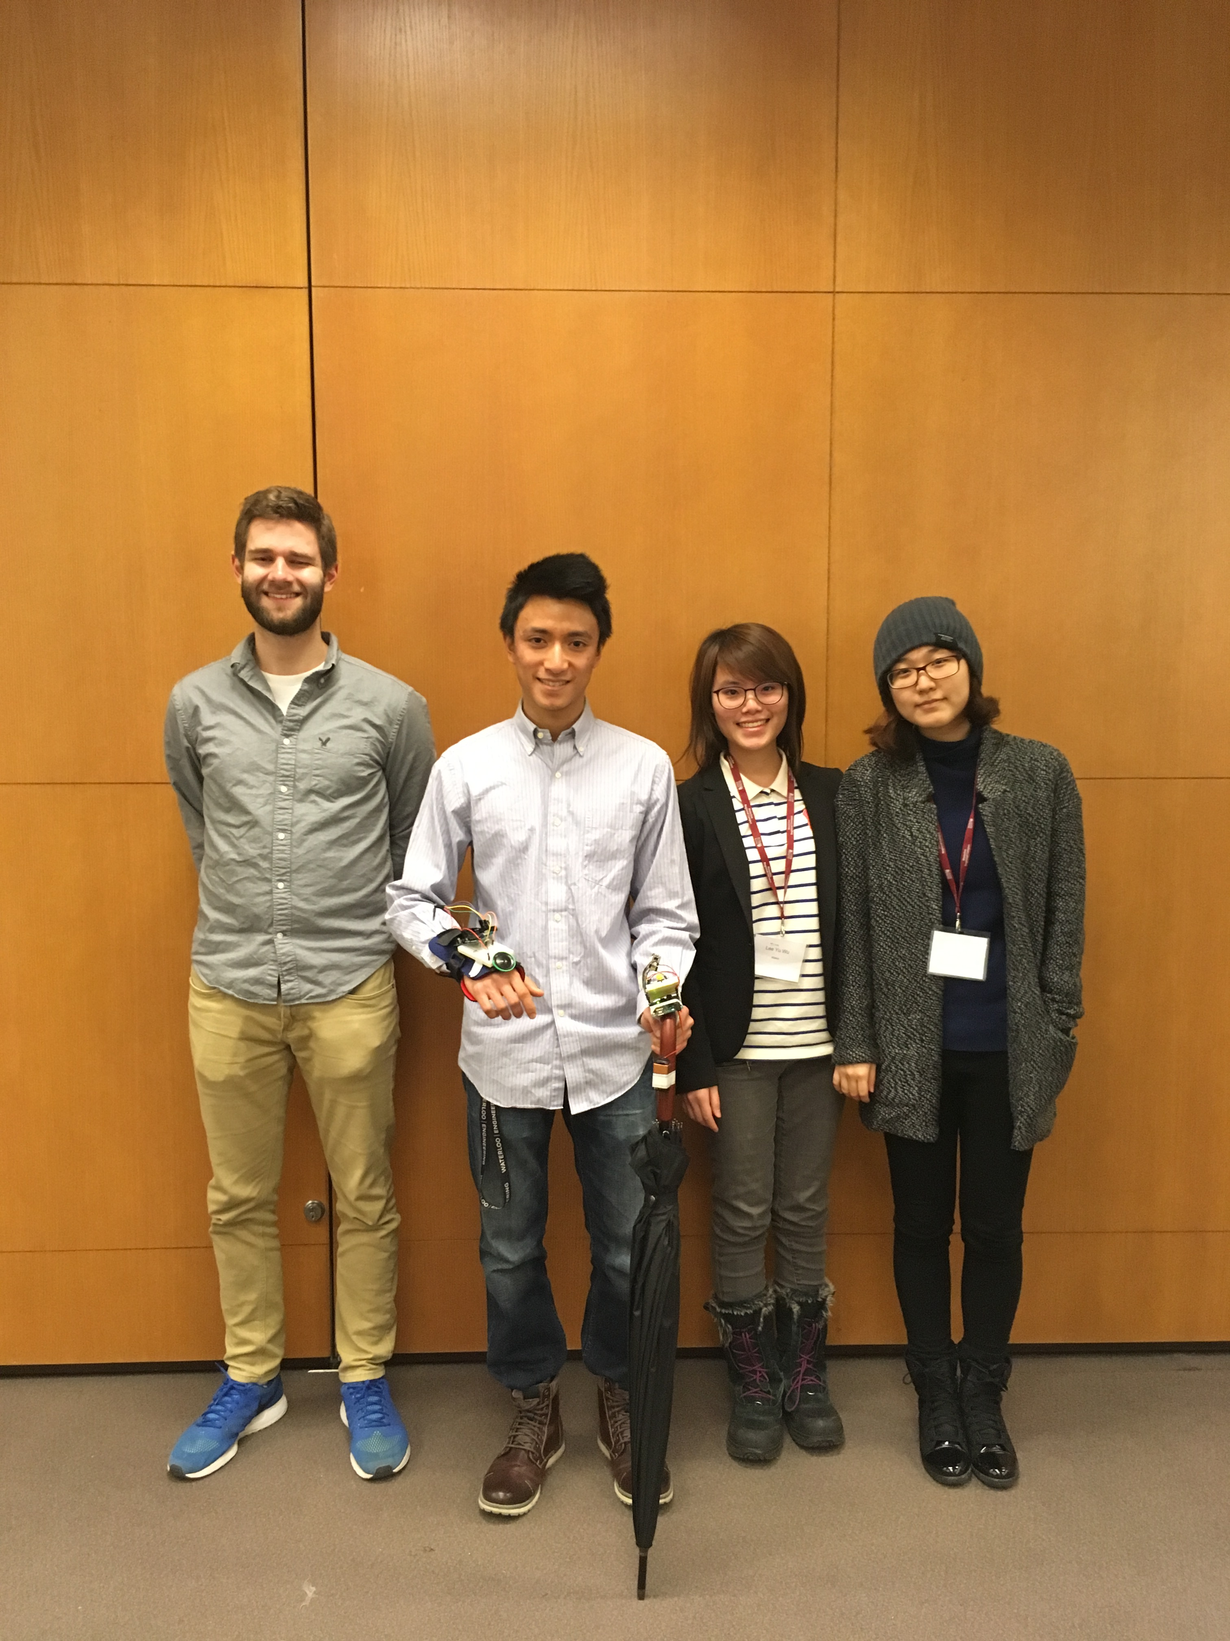
What We Need
Access to participants for testing
Business development & consultation
Funding for product development

Slide 11
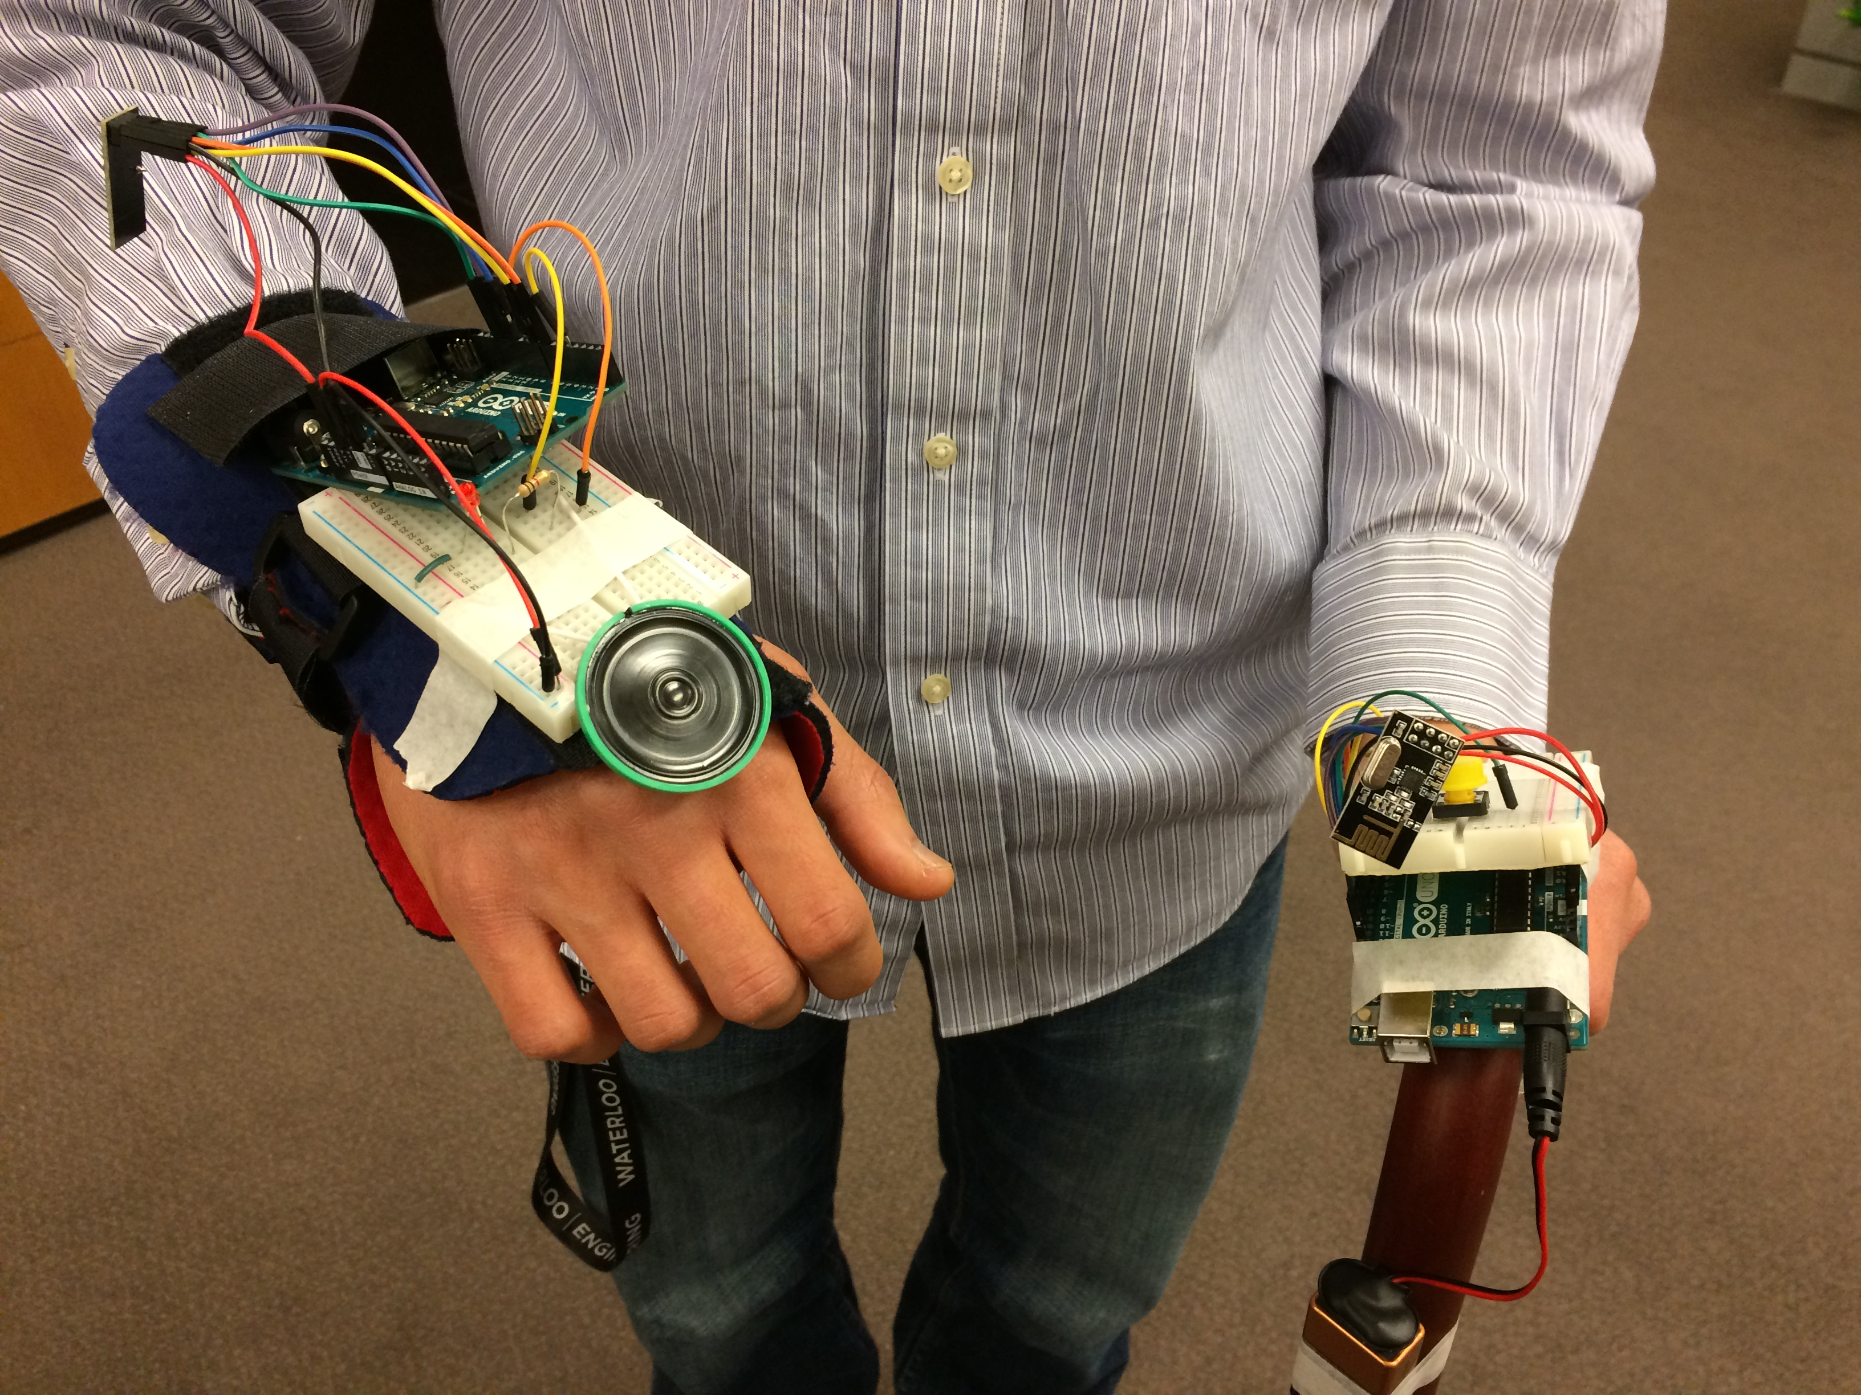
Sentinel
A Walker to Remember
-UWHIT

